Slide 1

IBM DATA SCIENCE CAPSTONE PROJECT
Business opportunity in Toronto, CanAda – by Rizky Novianto Pratama

Slide 2
Introduction & Business Problem
As a business and entrepreneurship enthusiast, i'd like to look for a business opportunities and gives my thought on: what the people are currently need? is it highly available on the market? if it isn’t, what can i do to meet those demands? how should I do it?
The problem in answering above question, it would take quite some time to gather information needed in a conventional way.
Using data science, we could tackle afore-mentioned problems:
Determine which business opportunity that is/are available
Spending money on investing required detailed and thorough analysis, which take quite some time to be done conventional way

Slide 3
Introduction & Business Problem
Who would be interested in this project?:
Investor looking for an opportunity to build a business
People that was looking for a preferred neighborhood to live
By knowing what people needs, we can use it to our advantage, to make profit from it. To start it all, first we need to know:
what are the frequently visited venue category in Toronto? (related to demands asked market)
who visited those venues?
is the population of Toronto can be grouped by ethnics?
Is what these ethnics needs already widely available in Toronto?

Slide 4
DATA
Now that i have defined the question, what data do i need to have in order to answer said question? :
Foursquare Location Data & Neighborhood Distribution Data
Distribution of venue category which available in Toronto
Which venue category are amongst the top frequently visited by people of Toronto
Ethnics demographic population in Toronto
Distribution of the majority ethnics that lived in Toronto
How many (headcount & percentage) people that belongs in that ethnics?
Where the majority ethnics are located (borough & neighborhood)?
Data
Insight
Determining what venue category still has room to grow in Toronto for business opportunity
People what business would potentially thrive and
Where should we build that potential business
Predicting which neighborhood that potentially be the second "home" for the majority ethnics

Slide 5
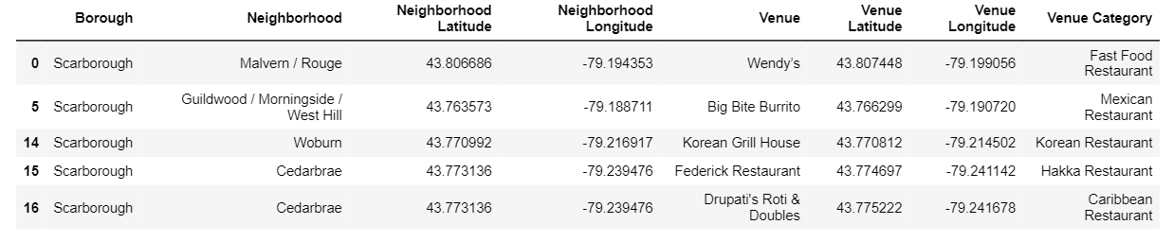
DATA – Foursquare Location & Neighborhood Distribution

Slide 6
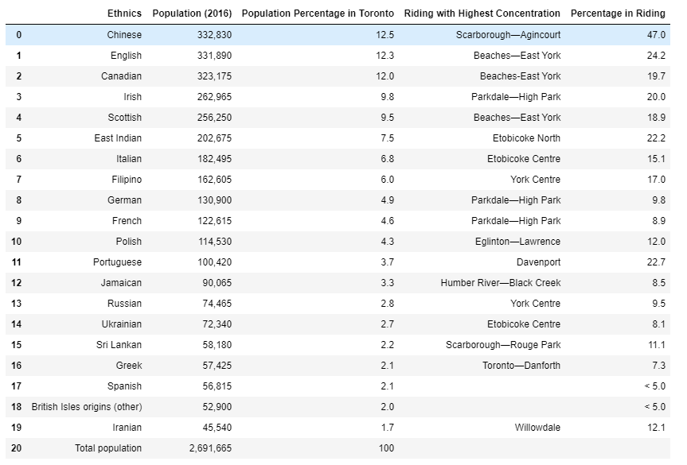
DATA – Ethnics demographic population in Toronto
2016 data shows that the Chinese is the most prevalent ethnics in Toronto, with a total of 332,830 headcounts, which about 12.5% of the entire Toronto population that year. About 47% of them lived in Agincourt, Scarborough.

Slide 7
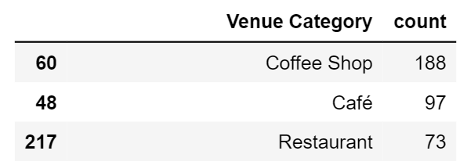
DATA – top three most frequently visited venue category
There are 270 unique venue categories
Coffee Shop & Cafe occupied both first and second place as the most visited venue in Toronto. As you can see, Restaurant still has room grow

Slide 8
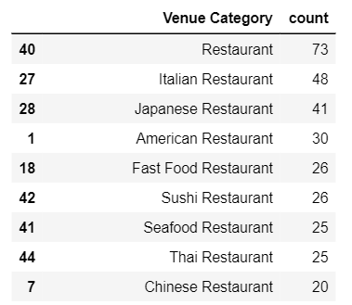
DATA – top 9 most frequently visited Restaurant category
From the list above, the most common restaurant that can be found is "Restaurant", followed by Italian and Japanese Restaurant. What's surprising, Chinese restaurant is at the 9th position of the most common restaurant category here in Toronto, while Chinese Ethnics counted for 12.5% of the whole Toronto Population.
This findings shows that there are a lot of room to grow for Chinese Restaurant in Toronto, for 332,830 people of Chinese Ethnics there are only 20 Chinese Restaurant available in the whole Toronto Area.

Slide 9
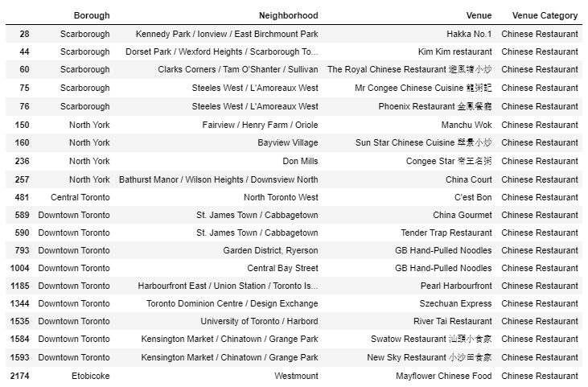
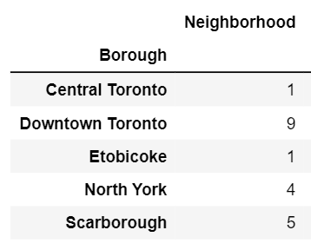
DATA – count of Chinese restaurant across toronto
Only 4 Chinese Restaurant are available in Scarborough, despite roughly 47% of Chinese people in Toronto are all live there.

Slide 10
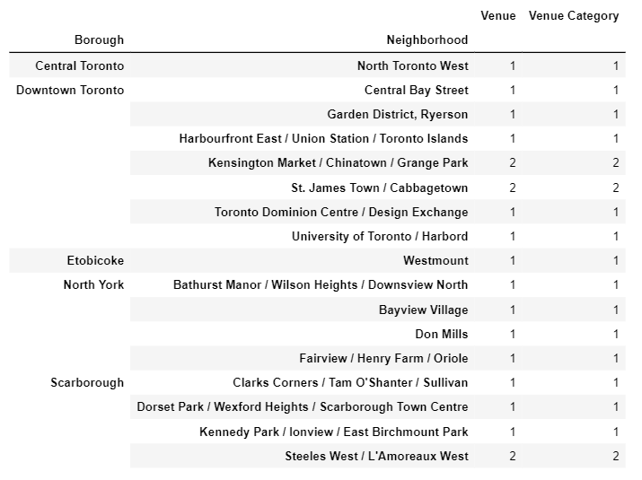
DATA – Location of Chinese Restaurant across toronto
None of the Chinese Restaurant are available in Agincourt! home to roughly 156,430 Chinese people in Toronto.
This means they have to travel to other neighborhoods in Scarborough, or even further to Downtown Toronto to get any Chinese dishes.

Slide 11
Discussion #1 – What kind of business is potential and where?
With this revelation, now we know that Chinese Restaurant still has a lot of room to grow, which is a based on the fact that:
Chinese Ethnic has the most population in Toronto compared to any other Ethnics (12.5% of Toronto, or about 332,830 people), where majority of the Chinese are lived in Agincourt - Scarborough.
There are lack of Chinese Restaurant is available, only 20 Chinese Restaurant can be found in whole Toronto, pale in comparison against Italian Restaurant.
There are only 4 Chinese Restaurants available in Scarborough,
None of the Chinese Restaurant are located within Agincourt.
Thus, if I want to build a restaurant in Toronto, based on the data that i have, it would be a Chinese Restaurant in Agincourt, home of 47% (156,430 headcounts) Chinese people in Toronto.

Slide 12
Next opportunity – Potential area to build next restaurant
If I want to set up another Chinese Restaurant in Toronto, i would pick a neighborhood where it will likely to be the second Agincourt.:
Why Agincourt?
because as the above data suggest majority of Chinese People lived in Agincourt, that means there are some things that made Agincourt are preferred for them to live
How?
What makes Agincourt is a desired place to be called a home by Chinese Ethnics could be determined by the availability and variety of Venue Category there. Therefore, I should find similar neighborhoods by clustering the neighborhoods based on the most common venue category for each neighborhood.

Slide 13
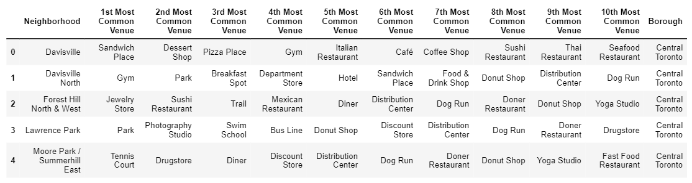
Next opportunity – top 10 most frequently visited venues in each neighborhood (5 samples)

Slide 14
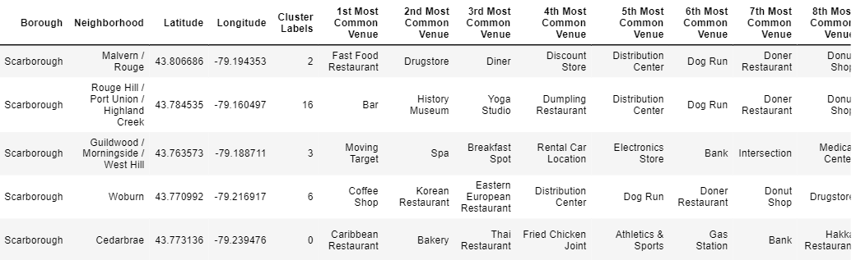
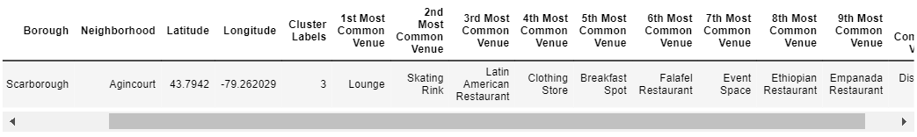
Next opportunity – cluster the neighborhood based on its similarities
As you can see, Agincourt included in Cluster Label number 3

Slide 15
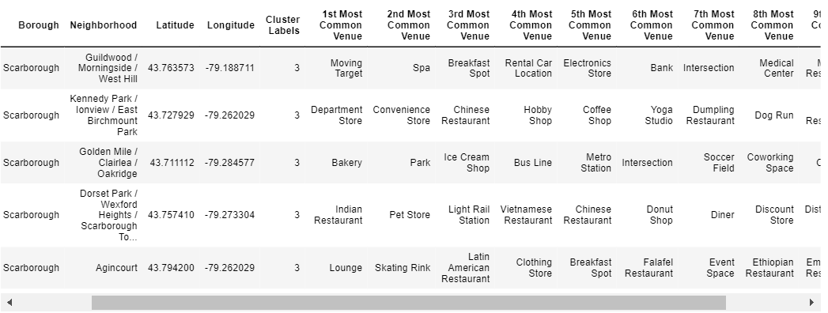
Next opportunity – cluster the neighborhood based on its similarities
Now, What are the other Neighborhoods that fall into the same Cluster Label as Agincourt but still within the same Borough (Agincourt belongs in Scarborough)
There are 4 other Neighborhoods that are similar with Agincourt in terms of top 10 Most Common Venue.
To narrow the options, let's see how many Venue Category available in each Neighborhood?

Slide 16
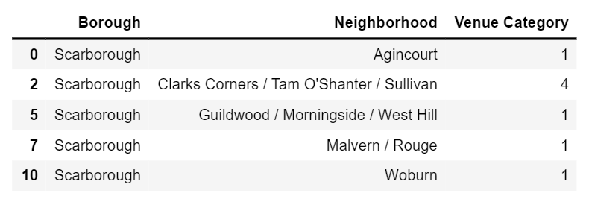
Next opportunity – cluster the neighborhood based on its similarities
Restaurant available in each neighborhood that belongs in the same cluster label as Agincourt

Slide 17
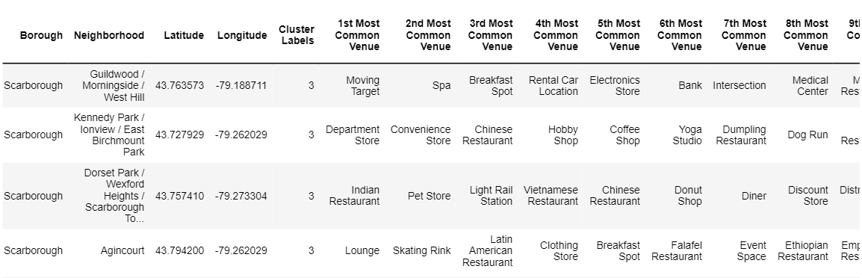
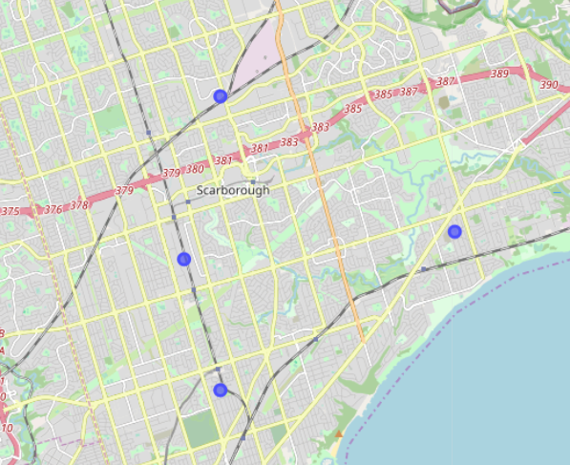
Next opportunity – neighborhoods within Scarborough that have any restaurant available, but share the same similarity with Agincourt

Slide 18
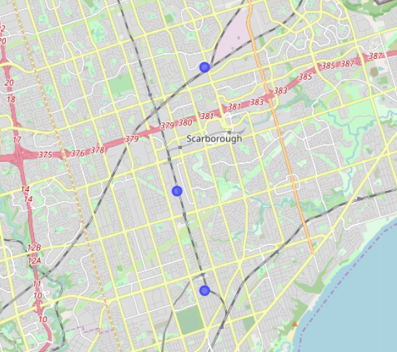
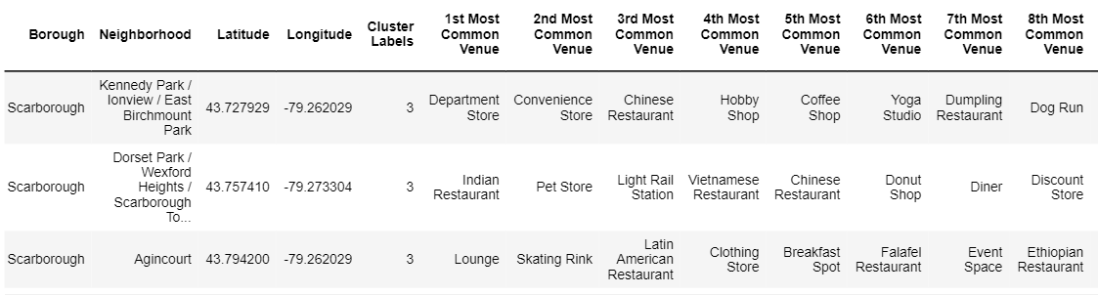
Next opportunity – neighborhoods within Scarborough that have Chinese restaurant available, but share the same similarity with Agincourt

Slide 19
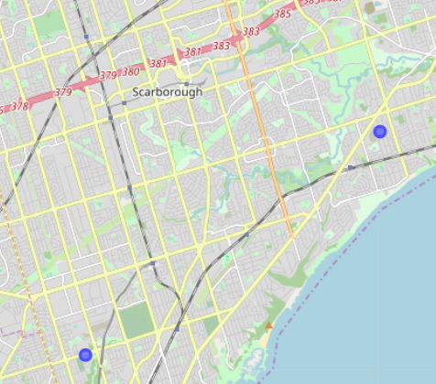
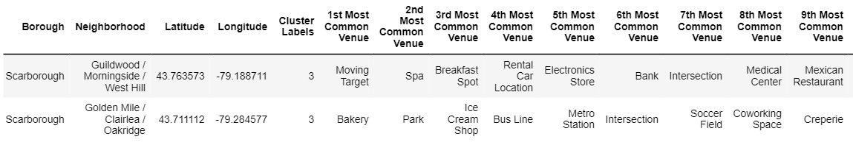
Next opportunity – neighborhoods within Scarborough that don’t have any Chinese restaurant available, but share the same similarity with Agincourt

Slide 20
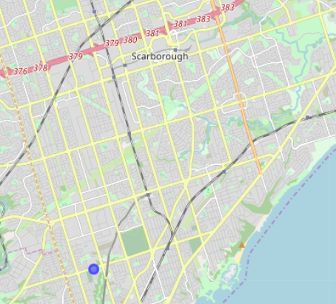
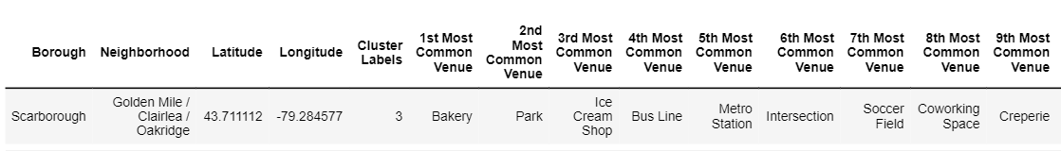
Next opportunity – neighborhoods within Scarborough that don’t have any restaurant available, but share the same similarity with Agincourt

Slide 21
Next opportunity – Discussion #2
With above data, now i know where should i build my next Chinese Restaurant outside of Agincourt, but still within Scarborough where no Chinese Restaurant are currently available. It would be:
Guildwood, Morningside, West Hill
Also with above data, I also know where should i build my next Chinese Restaurant outside of Agincourt, but still within Scarborough where no restaurant are currently available at all, it would be
Golden Mile / Clairlea / Oakridge

Slide 22
conclusion
If i want to build a new restaurant business in Toronto, that would be a Chinese Restaurant in Agincourt, Scarborough.
Why? because Chinese people are the most prevalent ethnics in Toronto (12.5% of Toronto population or 332,830 people), where most of them lived in Scarborough - Agincourt (47 % of total Chinese population or 156,430 people) while not even one Chinese Restaurant can be found in Agincourt.
For potential area to build my next Chinese Restaurant, I have potential places that I can pick that i grouped based on:
Outside of Agincourt, but still within Scarborough where no restaurant are currently available:
Golden Mile / Clairlea / Oakridge
Outside of Agincourt, but still within Scarborough where there are several non-Chinese restaurant already established:
Guildwood / Morningside / West Hill

Slide 23
Thankyou!

